Slide 1
SCIENTIFIC CALCULATOR USING HTML, CSS, JAVASCRIPT

Slide 2
History of html, css, javascript
HTML (HyperText Markup Language): Introduced by Tim Berners-Lee in 1991, HTML is the standard markup language for creating web pages. It provides the basic structure of websites, which was enhanced with the addition of new tags and attributes over time.
HTML5: Officially released in 2014, HTML5 introduced new elements, attributes, and behaviors, improving support for multimedia and making it easier to build complex web applications.
CSS (Cascading Style Sheets): Proposed by Håkon Wium Lie in 1994, CSS became a W3C standard in 1996. It was designed to enable the separation of document content (HTML) from document presentation (layout, colors, fonts).
JavaScript: Created by Brendan Eich in just 10 days in 1995 while working at Netscape, JavaScript was originally named Mocha, then LiveScript, before finally being named JavaScript. It was designed to make web pages interactive.
ECMAScript: JavaScript was standardized under the name ECMAScript by the European Computer Manufacturers Association (ECMA) in 1997. ECMAScript versions (ES5 in 2009, ES6/ECMAScript 2015, and subsequent annual releases) have continued to enhance the language.

Slide 3
INTRODUCTION TO SCIENTIFIC CALCULATOR
A scientific calculator is an advanced type of calculator designed to handle mathematical functions beyond basic arithmetic operations. Unlike standard calculators, which are limited to addition, subtraction, multiplication, and division, scientific calculators can perform a wide range of functions including trigonometric, logarithmic, and exponential calculations. They are essential tools for students, engineers, scientists, and anyone who needs to perform complex mathematical computations.
Key Features of a Scientific Calculator
Basic Arithmetic Operations: Addition, subtraction, multiplication, and division.
Trigonometric Functions: Sine (sin), cosine (cos), tangent (tan), and their inverses.
Logarithmic and Exponential Functions: Logarithms (log, ln) and exponential functions (e^x).
Roots and Powers: Square roots, cube roots, and other nth roots; powers of numbers.
Memory Functions: Storing and recalling values for complex calculations.
Parentheses: Handling complex expressions by managing the order of operations.
Constants: Access to mathematical constants like π (pi) and e (Euler's number).

Slide 4
HTML SOURCE CODE
<html>
<head>
<title>Scientific Calculator</title>
<link rel="stylesheet" type="text/css" href="ScientficCalculator.css">
</head>
<body>
<center>
<h1> SCIENTIFIC CALCULATOR</h1>
<script type="text/javascript" src="ScientficCalculator.js"></script>
<div class="ScientficCalculator">
<input type="text" id="result">
<div class="buttons">
<button onclick="clearsc()">C</button>
<button onclick="backspace()">DEL</button>
<button onclick="display('/')">/</button>
<button onclick="display('*')">X</button>
<button onclick="display('7')">7</button>
<button onclick="display('8')">8</button>
<button onclick="display('9')">9</button>
<button onclick="display('-')">-</button>

Slide 5
<button onclick="display('4')">4</button>
<button onclick="display('5')">5</button>
<button onclick="display('6')">6</button>
<button onclick="display('+')">+</button>
<button onclick="display('1')">1</button>
<button onclick="display('2')">2</button>
<button onclick="display('3')">3</button>
<button onclick="display('.')">.</button>
<button onclick="display('0')">0</button>
<button onclick="display('(')">(</button>
<button onclick="display(')')">)</button>
<button onclick="solve()">=</button>
<button onclick="display('Math.sin(')">sin</button>
<button onclick="display('Math.cos(')">cos</button>
<button onclick="display('Math.tan(')">tan</button>
<button onclick="display('Math.log(')">log</button>
<button onclick="display('Math.sqrt(')">sqrt</button>
<button onclick="display('Math.log10(')">log10</button>
<button onclick="display('Math.PI')">pi</button>

Slide 6
<button onclick="display('Math.E')">e</button>
</div>
</div>
</center>
</body>
</html>

Slide 7
CSS SOURCE CODE
body{
background-image:linear-gradient(to right,#12c2e9 , #c471ed , #f64f59) ;
justify-content: center;
}
h1{
color: ghostwhite;
}
#result{
width: 400px;
padding: 10px;
font-size: 1.5em;
border: none;
margin-bottom: 10px;
color: ghostwhite;
background-color: transparent;
}
.buttons{
display: grid;
grid-template-columns: repeat(4,1fr);
gap: 10px;
width: 400px;
}

Slide 8
button{
padding: 20px;
border: none;
background-color: transparent;
color: ghostwhite;
font-family: Times New Roman;
font-size: 16px;
font-weight: bold;
border-radius: 50%;
}
button:hover{
background-color: hotpink;
}

Slide 9
JAVASCRIPT SOURCE CODE
function display(val){
document.getElementById('result').value += val;
}
function backspace() {
let d=document.getElementById('result');
d.value=d.value.slice(0,-1);
}
function clearsc(){
document.getElementById('result').value='';
}
function solve(){
let x = document.getElementById('result').value
try{
let y = eval(x);
document.getElementById('result').value = y
}
catch(error){
x='Error';
}
}

Slide 10
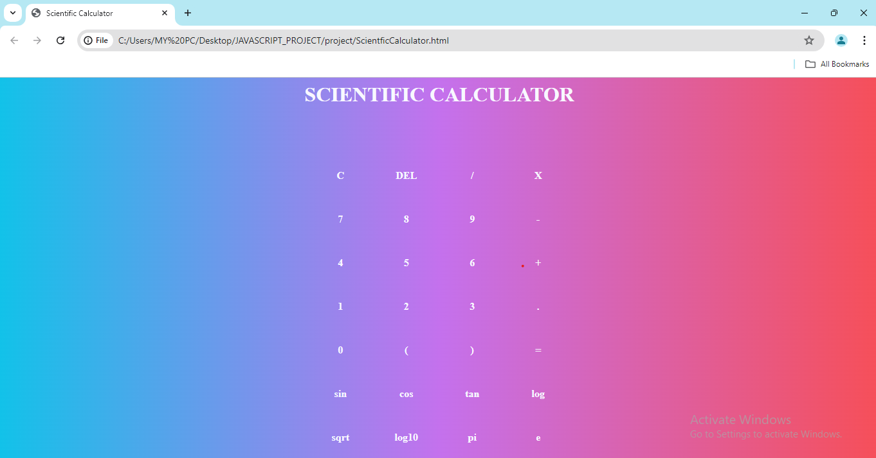
The output looks like ;

Slide 11
GITHUB LINKS
HTML CODE:
https://github.com/DesuRamya/javaScript/blob/main/project1/ScientficCalculator.html
CSS CODE:
https://github.com/DesuRamya/javaScript/blob/main/project1/ScientficCalculator.css
JAVASCRIPT CODE:
https://github.com/DesuRamya/javaScript/blob/main/project1/ScientficCalculator.js
OUTPUT VIDEO:
https://github.com/DesuRamya/javaScript/blob/main/project1/Scientific%20Calculator%20-%20Google%20Chrome%202024-06-25%2019-54-32.mp4

Slide 12
CONCLUSION
The scientific calculator project, developed using HTML, CSS, and JavaScript, successfully demonstrates the integration of web technologies to create a functional and user-friendly application.
HTML provided the structure, CSS enhanced the visual appeal and responsiveness, and JavaScript powered the core logic and interactivity.
The calculator supports a wide range of scientific operations, offering users advanced mathematical capabilities in a straightforward and intuitive interface.
This project not only highlights the potential of front-end development but also lays a strong foundation for future enhancements and additional features.

